Slide 1

Two Dimensional Array

Slide 2
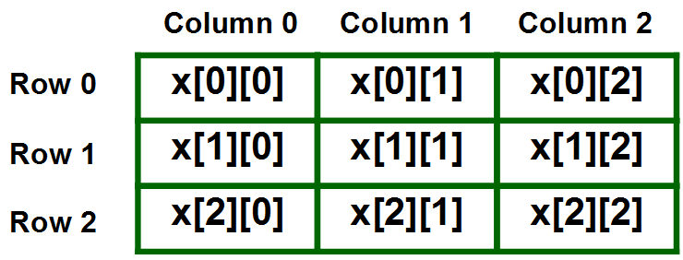
Two (Multi-dimensional) Dimensional Array –
The multidimensional array is also known as rectangular arrays in C++. It can be two dimensional or three dimensional. The data is stored in tabular form (row ∗ column) which is also known as matrix.
Syntax - data type array-name[size][size];
Note:
2D arrays can be defined as an array of arrays.
It can also represent a Matrix.

Slide 3
Initializing a 2D array in C++ -
Type – I
int arr[4][2] = {
{1234, 56},
{1212, 33},
{1434, 80},
{1312, 78}
} ;
Type – II
int arr[4][2] = {1234, 56, 1212, 33, 1434, 80, 1312, 78};

Slide 4

Printing a 2D Array in C++ -
Taking 2D Array Elements As User Input -
#include<iostream.h>
void main( )
{
int arr[4][2] = {
{ 10, 11 },
{ 20, 21 },
{ 30, 31 },
{ 40, 41 }
} ;
int i,j;
cout<<"Printing a 2D Array:\n";
for(i=0;i<4;i++)
{
for(j=0;j<2;j++)
{
cout<<"\t"<<arr[i][j];
}
cout<<endl;
}
}
#include<iostream>
using namespace std;
main( )
{
int s[2][2];
int i, j;
cout<<"\n2D Array Input:\n";
for(i=0;i<2;i++)
{
for(j=0;j<2;j++)
{
cout<<"\ns["<<i<<"]["<<j<<"]= ";
cin>>s[i][j];
}
}
cout<<"\nThe 2-D Array is:\n";
for(i=0;i<2;i++)
{
for(j=0;j<2;j++)
{
cout<<"\t"<<s[i][j];
}
cout<<endl;
}
}

